Slide 1
An AI-Powered Receipt & Invoice Analyzer
CAPSTONE PROJECT
Presented By:
Student Name- Mannat Sharma
College Name- Sanatan Dharma College, Ambala Cantt
Department- BBA | Commerce and Management
4. AICTE ID- STU6a2da00d593fb1781374989

Slide 2
OUTLINE
Problem Statement (Should not include solution)
Proposed System/Solution
System Development Approach (Technology Used)
Algorithm & Deployment
Result
Conclusion
Future Scope
References

Slide 3
Problem Statement
Organizations, shopkeepers, and individuals handle numerous receipts and invoices containing important transaction details such as business information, dates, purchased items, quantities, prices, taxes, discounts, and final amounts.
Manually reading and organizing this information is time-consuming and can lead to human errors. The problem becomes more challenging because receipts and invoices may have different formats, layouts, image quality, and levels of text clarity.
Therefore, there is a need to accurately extract visible information from receipt and invoice images, organize it into a structured format, and check whether the available financial calculations are internally consistent without guessing missing information.

Slide 4
Proposed Solution
The proposed system is an AI-Powered Receipt and Invoice Analyzer designed to automatically analyze receipt and invoice images using Multimodal Generative AI. The system aims to convert unstructured visual information from financial documents into a clear, organized, and easy-to-understand format.
1. Image-Based Document Upload
The system allows users to upload receipt or invoice images in supported formats such as JPG, JPEG, and PNG for AI-based analysis.
2. Intelligent Information Extraction
The AI analyzes the uploaded document and extracts clearly visible information, including the business or store name, address, date, time, invoice or receipt number, and payment details.
3. Automatic Item and Transaction Analysis
The system identifies individual purchased items along with their quantity, unit price, and total amount wherever the information is clearly visible.
4. Financial Details Extraction
Important financial information such as subtotal, tax, discount, additional charges, and final payable amount is extracted and presented in an organized manner.
5. Handling of Unclear or Missing Information
If any text or value cannot be clearly identified from the uploaded image, the system marks it as “Not readable” instead of making assumptions or generating incorrect information.
6. User-Friendly AI Application
The proposed solution provides a simple interface where users can upload a document, initiate the analysis, and quickly receive a structured summary of the extracted information.
Overall, the proposed system demonstrates how Multimodal Generative AI can be used to simplify document analysis, reduce manual effort, and transform receipt and invoice images into meaningful and structured information.

Slide 5
System Approach
The system follows the following workflow:
Image Upload → Image Processing → AI Analysis → Information Extraction → Structured Output → Arithmetic Verification
Step 1: Image Upload
The user uploads a receipt or invoice in JPG, JPEG, or PNG format.
Step 2: Image Processing
The uploaded image is opened and prepared for analysis.
Step 3: AI Analysis
The image and a detailed instruction prompt are sent to the Gemini multimodal AI model.
Step 4: Information Extraction
The AI identifies clearly visible information from the document.
Step 5: Structured Output
The extracted information is presented using tables and headings.
Step 6: Verification
The system checks whether subtotal, tax, discount, and final amount calculations appear consistent based on the visible values.

Slide 6
TECHNOLOGY USED
Component | Technology
Programming Language | Python
User Interface | Streamlit
Generative AI Model | Gemini 3.6 Flash
AI Capability | Multimodal Generative AI
AI Integration | Google Generative AI API / SDK
Image Processing | Pillow (PIL)
Input Format | JPG, JPEG, PNG
Document Analysis | AI-based Visual Understanding
Information Extraction | Multimodal AI
Output Format | Structured Text and Tables
Development Environment | Visual Studio Code
Deployment Platform | Streamlit Community Cloud

Slide 7
Algorithm & Deployment
The proposed system uses the Gemini 3.6 Flash Multimodal Generative AI model for analyzing receipt and invoice images. The model is selected because it can understand both visual content and textual instructions, making it suitable for extracting information from documents with different formats and layouts.
Data Input
The system takes a receipt or invoice image in JPG, JPEG, or PNG format as input. The image is analyzed along with a structured prompt that instructs the AI to extract visible details such as business information, purchased items, quantities, prices, tax, discounts, and final amounts.
Analysis Process
The uploaded image and prompt are sent to the Gemini 3.6 Flash model for analysis. The AI identifies clearly visible information, organizes it into structured sections and tables, and marks unclear values as “Not readable” instead of guessing.
Verification Process
The system checks whether visible financial values, such as the subtotal, tax, discount, and final amount, appear to be internally consistent based on the available information.
Deployment
The application is developed using Python and Streamlit and can be deployed as a web-based application. Users can upload a receipt or invoice image through the interface and receive the AI-generated analysis directly on the screen.
Deployment Flow: User → Streamlit Web Application → Gemini 3.6 Flash → Structured Analysis Result

Slide 8
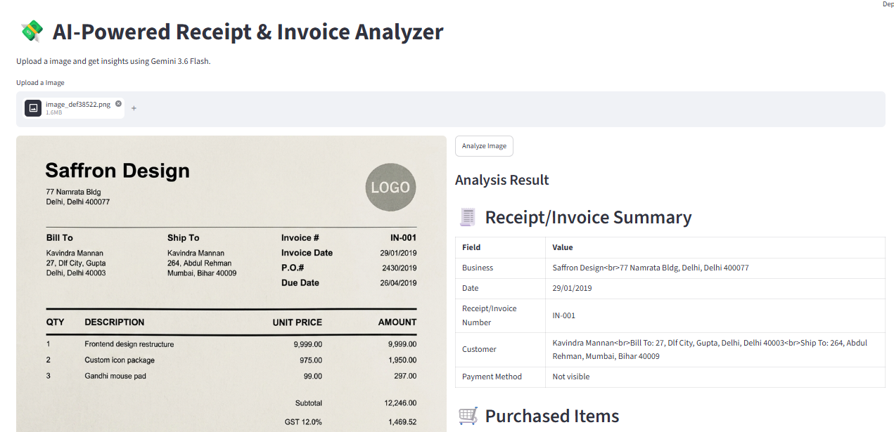
Result

Slide 9
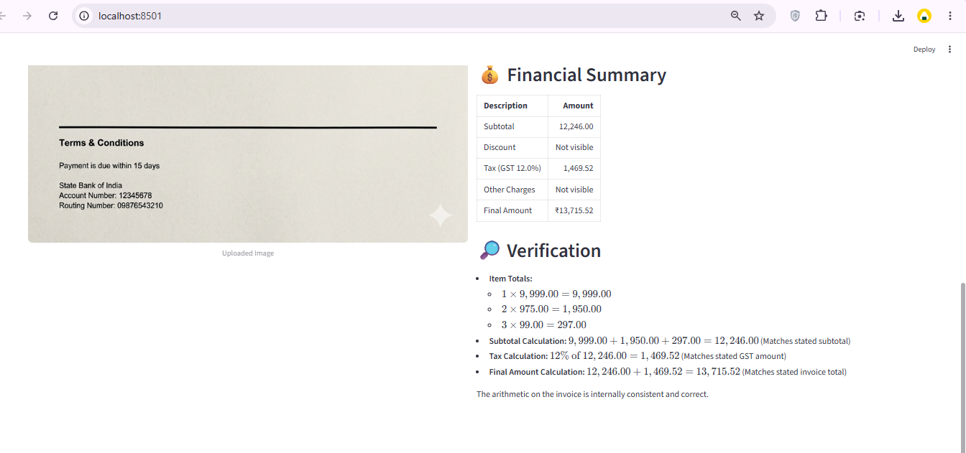
Result

Slide 10
Conclusion
and invoice images and extract clearly visible information such as business details, purchased items, quantities, prices, taxes, dThe AI-Powered Receipt and Invoice Analyzer demonstrates the practical use of Multimodal Generative AI for analyzing financial documents. The system uses Gemini 3.6 Flash to understand uploaded receipt iscounts, and final amounts.
The extracted information is presented in a structured and easy-to-understand format. The system also avoids guessing missing or unclear information by marking such values as “Not readable” and checks whether the visible financial calculations appear internally consistent.
Overall, the project shows how Generative AI can help reduce manual effort, improve the organization of document information, and provide a simple and user-friendly approach to receipt and invoice analysis.

Slide 11
Future scope
The AI-Powered Receipt and Invoice Analyzer can be further enhanced with the following features:
PDF and Multiple Document Support: Enable analysis of PDF files and multiple receipts or invoices at the same time.
Excel and CSV Export: Allow users to download the extracted information in Excel or CSV format for easier record management.
Expense Categorization: Automatically categorize expenses such as food, travel, shopping, utilities, and business expenses.
Multi-Language Support: Analyze receipts and invoices written in different languages.
Improved Image Processing: Enhance the analysis of blurred, low-quality, tilted, or poorly scanned documents.
Database Integration: Store analyzed receipts and invoices securely for future access and record management.
Expense Analytics Dashboard: Provide visual summaries and insights into spending patterns and expenses.
Integration with Accounting Systems: Connect the application with accounting or financial management platforms.
Overall, these enhancements can make the system more efficient, scalable, and useful for both individuals and businesses.

Slide 12
References
References
Google AI for Developers. Gemini API Documentation.
Google Generative AI. Gemini Models and Multimodal AI Documentation.
Streamlit. Streamlit Documentation.
Python Software Foundation. Python Documentation.
Pillow. Python Imaging Library (PIL) Documentation.
GitHub. Source Code Repository and Version Control Platform.
Project Links
GitHub Repository: Deployment : Streamlit Community Cloud

Slide 13
Deployment link / github link
Github Link:
Deployment: HF, Streamlit Link, Gradio (OPTIONAL)
Streamlit

Slide 14
THANK YOU

